Slide 1
Nerida Wilson
Northern Coroner
Coroners Court of Queensland
Cairns Court Complex
5D Sheridan St
(PO Box 1110)
CAIRNS QLD 4870

Slide 3
Coroners Court of Queensland
8 Coroners – all Magistrates
(not medically qualified)
1 x State Coroner
1 x Deputy State Coroner
2 x Brisbane Coroners
3 x Regional Coroners (Southern; Central and Northern)
1 x Specialist DV Coroner

Slide 4
Introduction
Appointed the Northern Coroner for Queensland in 2017; based in Cairns centrally placed within the expansive northern coronial boundaries, encompassing the Torres Strait, south to Proserpine, west to Birdsville and following the Northern Territory border north to the Gulf of Carpentaria and Mornington Island.
The northern coronial district encompasses a combined 39 distinct Aboriginal and Torres Strait Island communities.

Slide 5
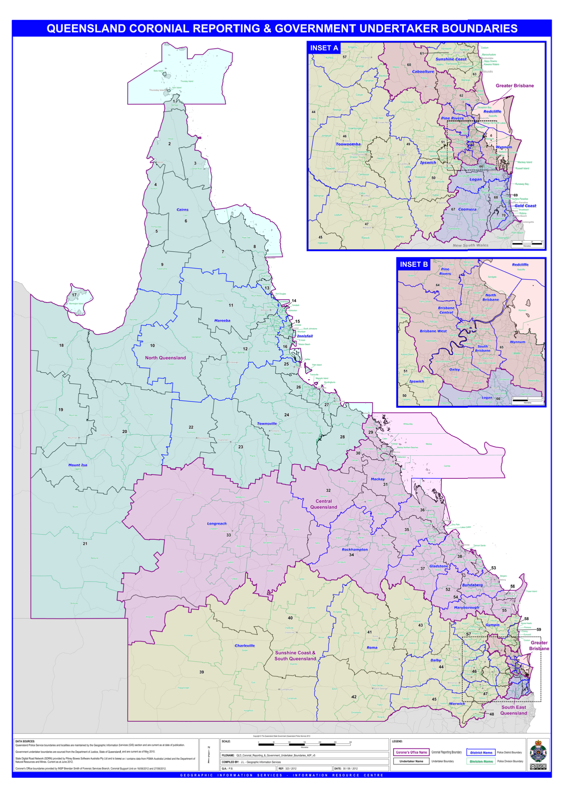

Slide 6
THE STATS
Over 6000 reportable deaths per year in Qld
Approx 2500 + autopsies per year Qld (internal / external / partial )
Northern region accounts for 600 - 700 reportable deaths per year
TOP THREE CATEGORIES OF REPORTABLE DEATHS
Natural causes 43.3%
Domestic accident 13.5%
Suicide 13.4%
Over 32,000 deaths from all causes in Qld each year – 2667 per month
86%-89% of deaths in Australia certified by a doctor (balance certified by Coroners)

Slide 7
According to the 2020 Queensland Chief Health Officer’s Health of Queenslanders report suicide was number 8 in the list of leading causes of death in 2018 (most recent data available).
Coronary heart disease (12.8%)
Dementia (7.8%)
Cerebrovascular disease (6.7%)
Lung cancer (5.8%)
COPD (4.7%)
Colorectal cancer (3.6%)
Diabetes (2.9%)
Suicide (2.5%)
Suicide is the 18th leading cause of death for women (1.8%), 8th for men (3.6%), and 8th overall (2.5%).

Slide 8
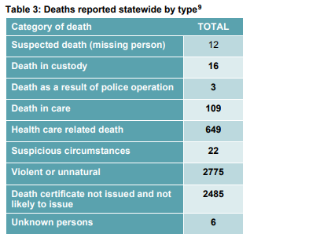

Slide 9
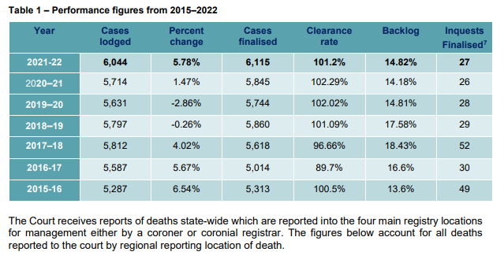

Slide 10
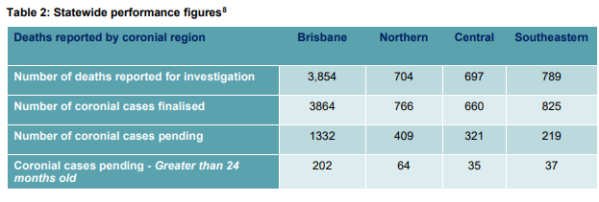

Slide 11
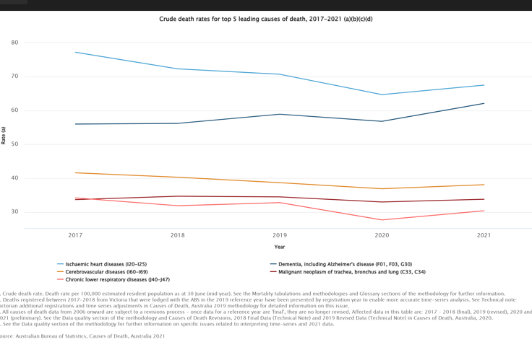

Slide 13
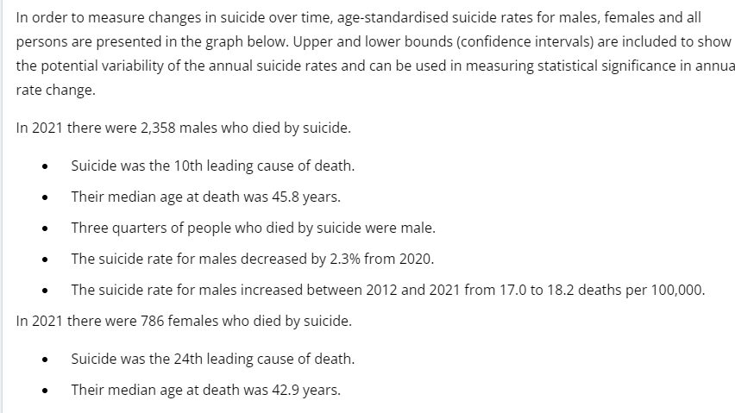

Slide 14
The 2020 Annual Report of the Queensland Suicide Register indicates that Queensland has one of the highest suicide rates in Australia. In 2018 there were 3,046 deaths by suicide registered in all of Australia and Queensland accounted for 25.8% of these deaths, despite Queensland representing only 20.1% of Australia’s population.

Slide 15
ABS data shows that intentional self-harm is the leading of cause of death in all ages groups in Qld between
15 and 44 years.

Slide 16
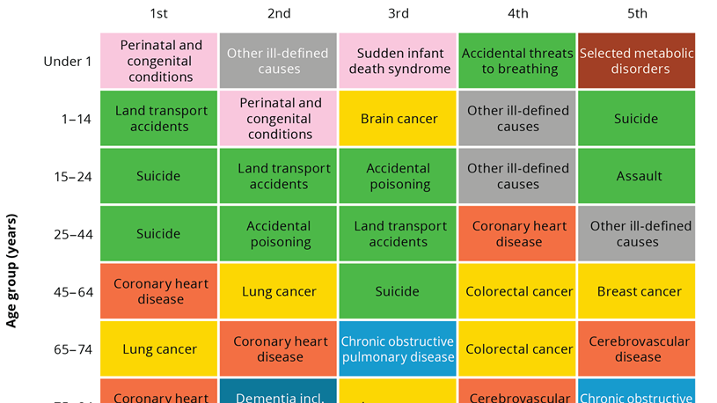

Slide 17
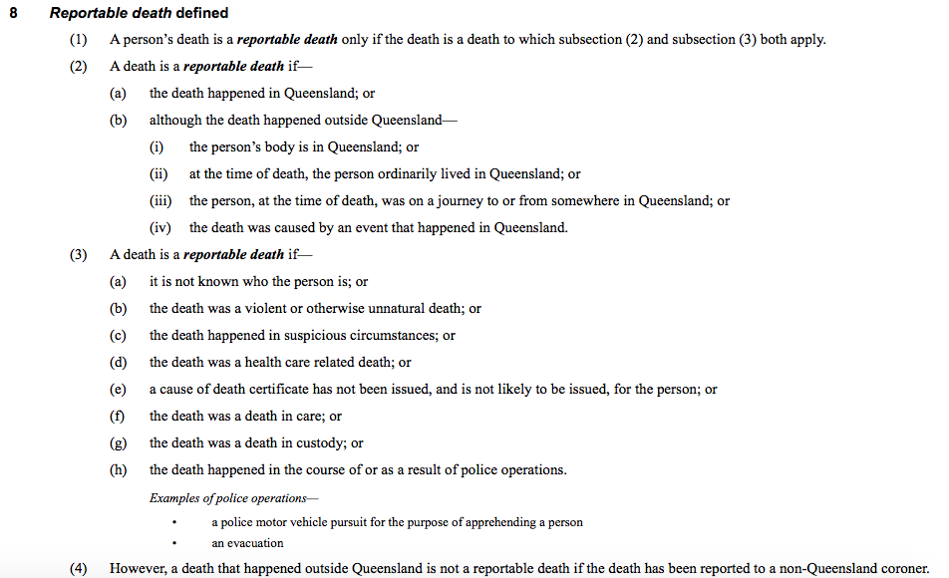

Slide 20
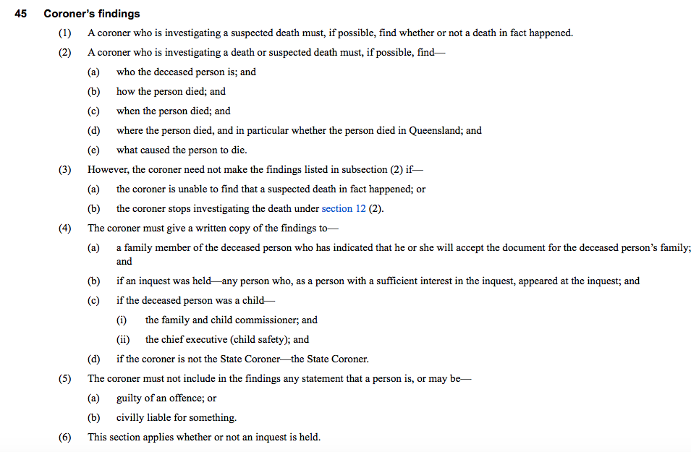

Slide 21
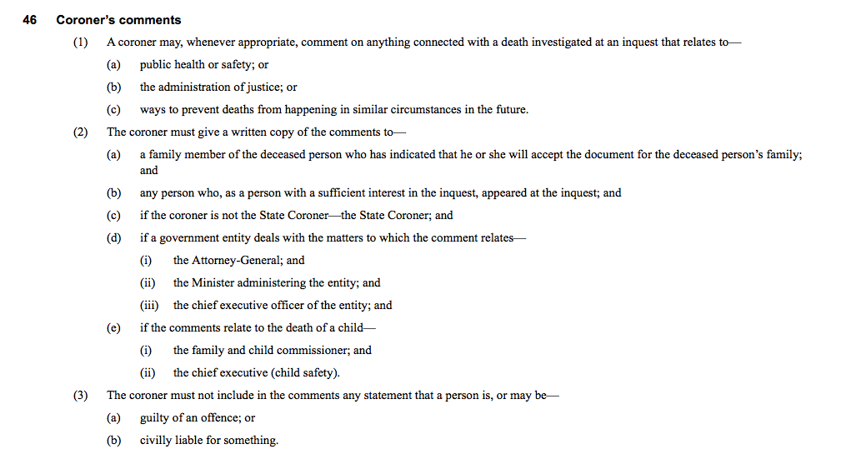

Slide 22
A very typical DAY
Form 1 Police Report of Death to Coroner

Slide 23
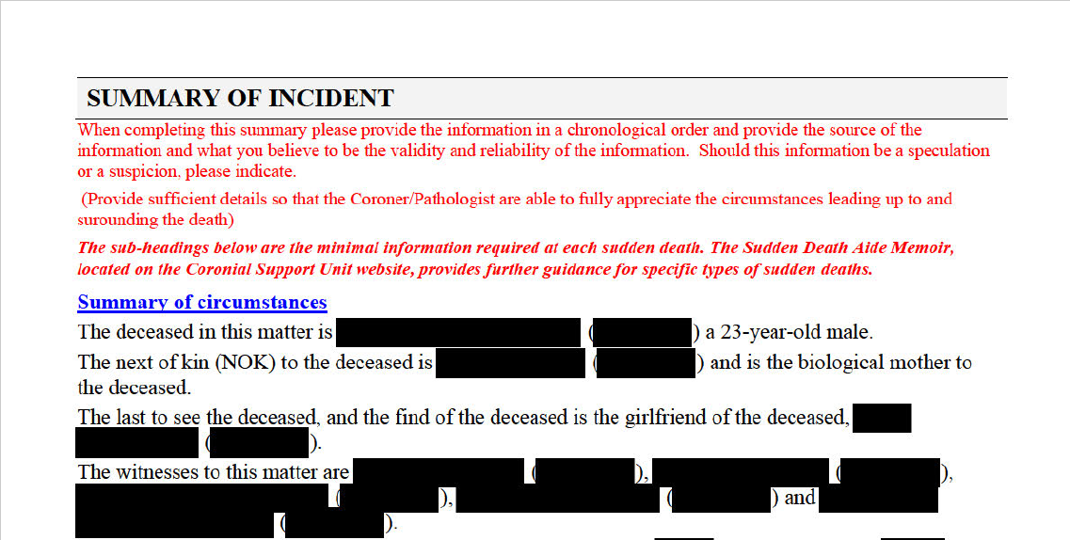

Slide 24
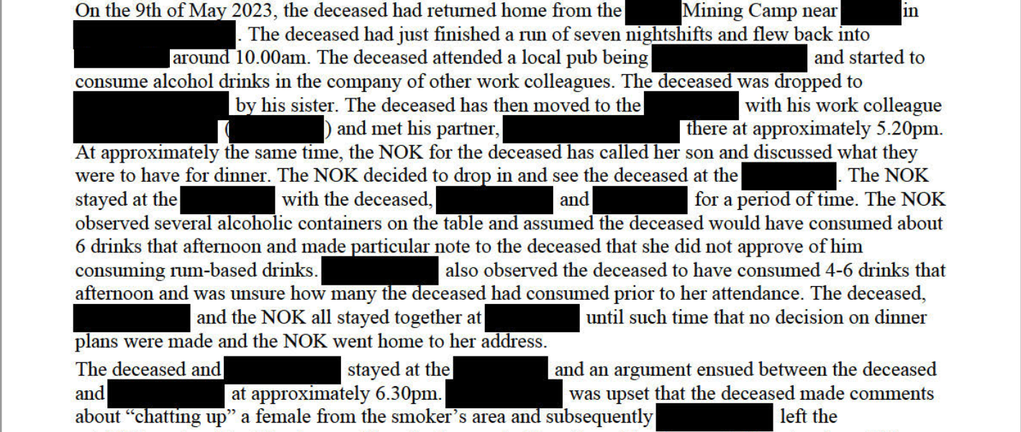

Slide 25
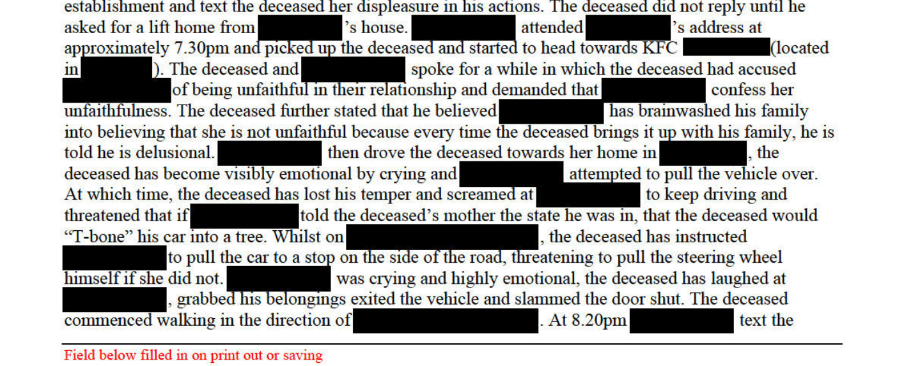

Slide 26
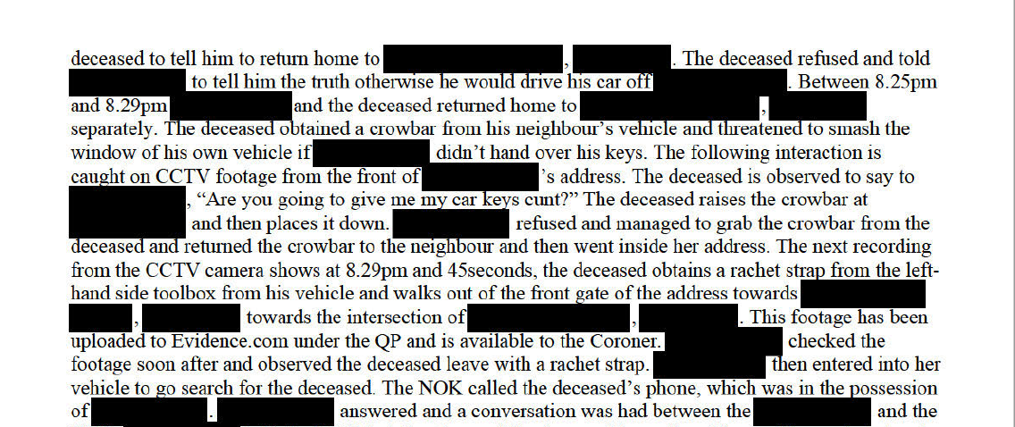

Slide 27
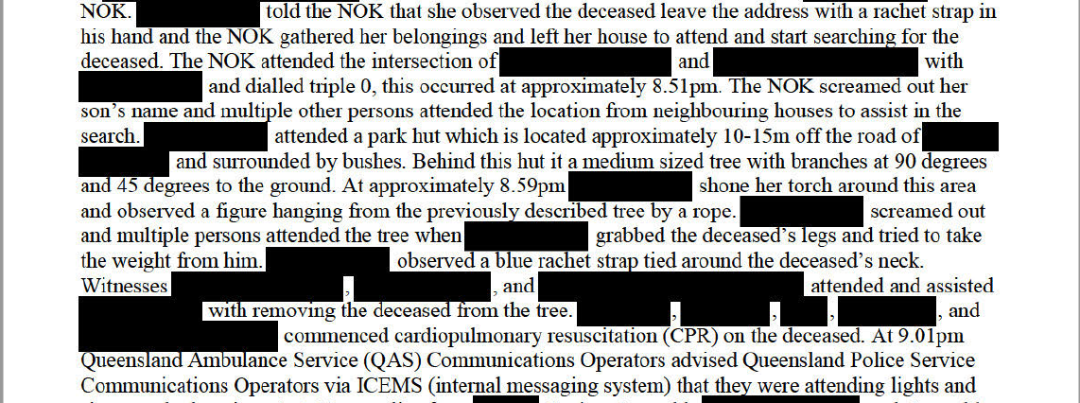

Slide 28
CORONERS FINDINGS
At the conclusion of the investigation the coroner will issue findings – either after an Inquest or in Chambers (non-inquest findings)
For example…

Slide 29
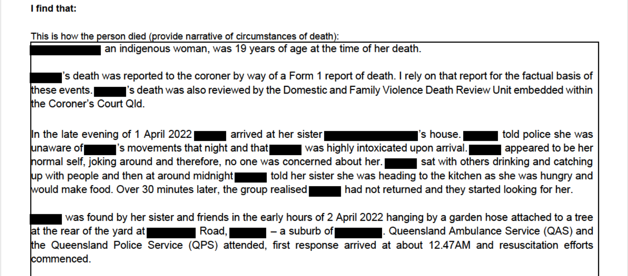

Slide 30
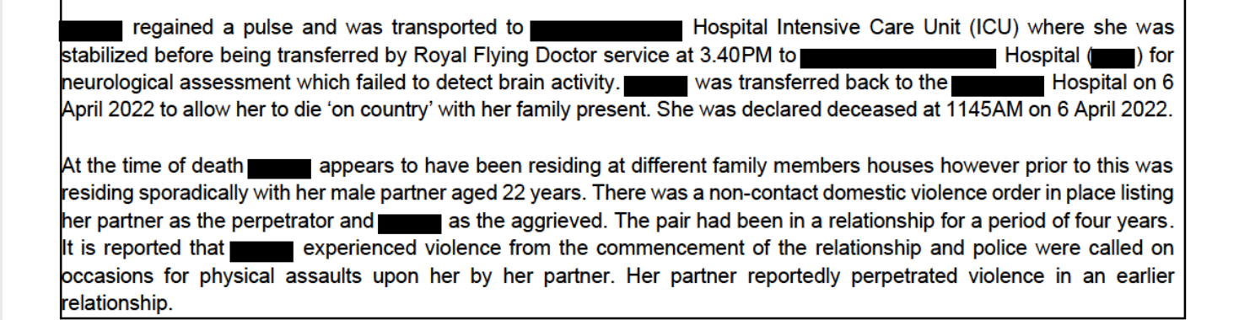

Slide 33
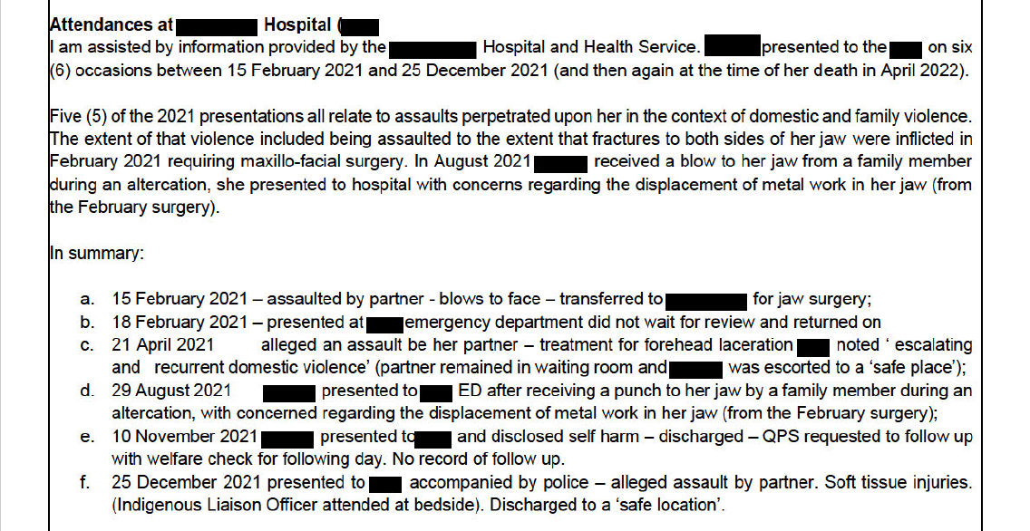

Slide 34
Apparent domestic and family violence homicides from 2006-7 to 2020-21
Notes:
Between 1 July 2006 and 30 June 2021, there were 375 domestic and family violence homicides in Queensland. This includes 346 women, children and men who were killed by a family member or by someone they were, or had been, in an intimate partner relationship with. An additional 29 collateral homicides occurred during this time. Collateral homicides are people who may have been killed while intervening in a domestic and family violence episode, or a person who was killed by their partner’s former spouse.
There were 41 homicide-suicide events in Queensland between 1 July 2006 and 30 June 2021, resulting in 53 deceased.
Males were the homicide offender in 76.5% of all domestic and family violence homicides, including collateral homicides.
Of the homicide deceased in a family relationship, 55.6% were children. This means that almost one-quarter (23.7%) of domestic and family violence homicides in Queensland were homicides of children who were killed by a parent or caregiver (filicide).

Slide 35
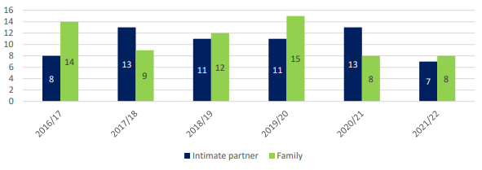
Apparent domestic and family violence homicides from 2016 to 2022 (129 in total)
Notes:
Between 1 July 2016 and 30 June 2022, there were 129 homicides that occurred in an intimate partner or family relationship in Queensland. This included the deaths of 129 women, children and men who were killed by a family member or a current or former intimate partner. As shown above, of the 129 homicides that occurred during this period, 63 were intimate partner homicides and 66 were family homicides.

Slide 36
Many Domestic Violence deaths have predictive elements to them.
“
”
State Coroner Terry Ryan
Chair
DFV Death Review and Advisory Board

Slide 37
Presence of KEY LETHALITY RISK INDICATORS IN IPV RELATED HOMICIDES 2011-2018 (where recorded)
INTUTIVE SENSE OF FEAR
NON LETHAL STRANGULATION
ESCALATION
THREATS TO KILL
SEXUAL VIOLENCE
53.2%
26.1%
37%
35.9%
15.2%

Slide 38
